Slide 1
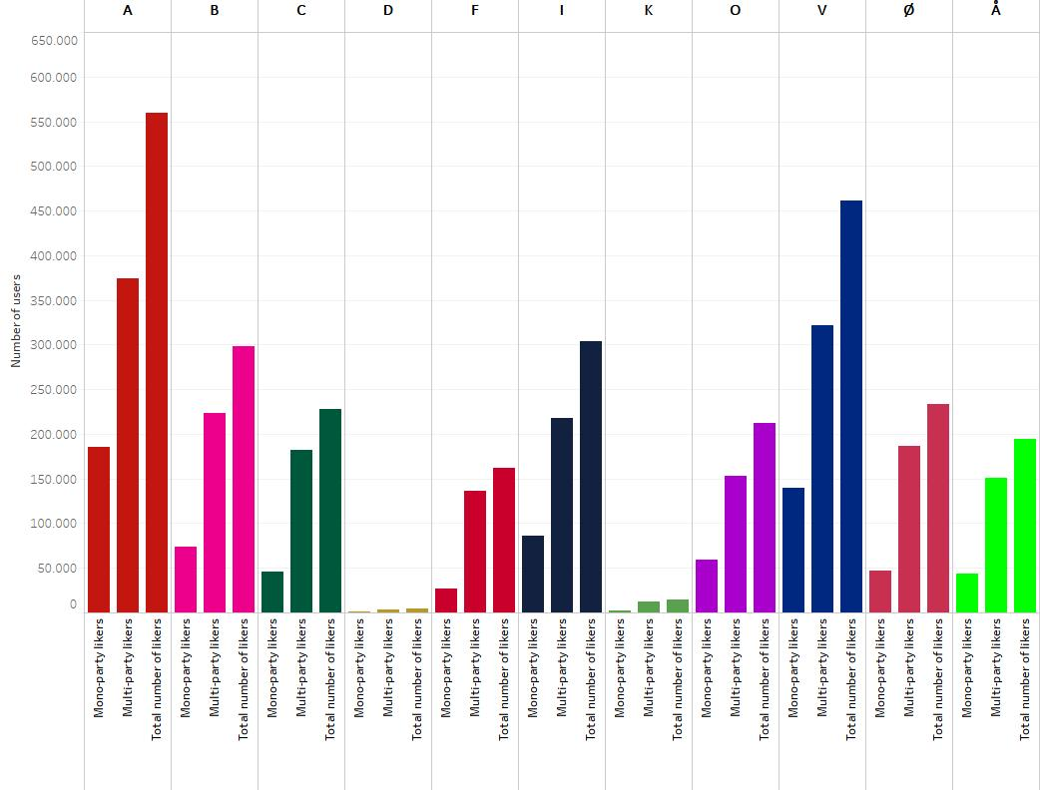
This graph shows how many unique users like posts from pages affiliated with Danish political parties on Facebook
33% mono- party likers
30% mono-party likers
25% mono- party likers
28% mono- party likers
20% mono- party likers
20% mono-party likers
28% mono-party likers
22% mono-party likers
16% mono- party likers
18% mono- party likers
16% mono-party likers

